Slide 1
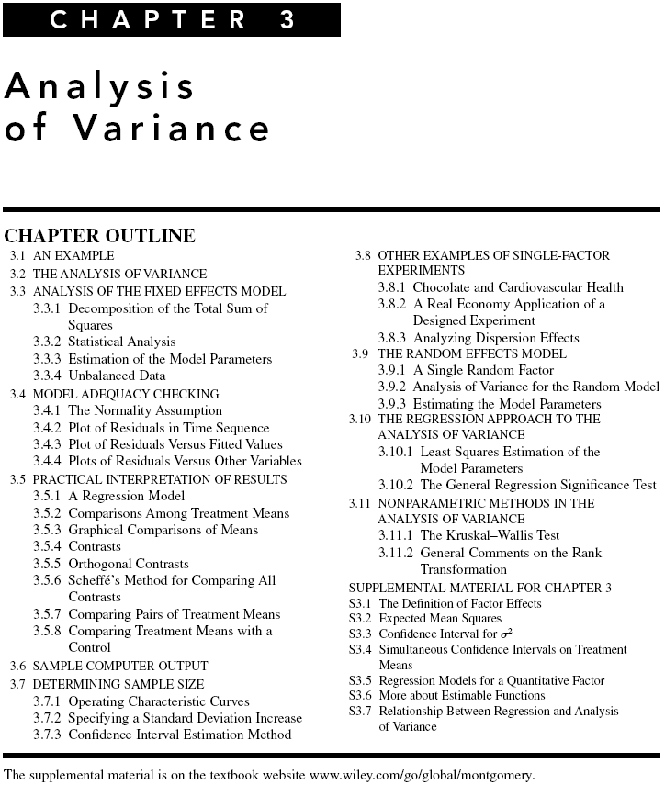
Chapter 3
Design & Analysis of Experiments 8E 2012 Montgomery

Slide 2
What If There Are More Than Two Factor Levels?
The t-test does not directly apply
There are lots of practical situations where there are either more than two levels of interest, or there are several factors of simultaneous interest
The analysis of variance (ANOVA) is the appropriate analysis “engine” for these types of experiments
The ANOVA was developed by Fisher in the early 1920s, and initially applied to agricultural experiments
Used extensively today for industrial experiments
Chapter 3
Design & Analysis of Experiments 8E 2012 Montgomery

Slide 3
An Example (See pg. 66)
An engineer is interested in investigating the relationship between the RF power setting and the etch rate for this tool. The objective of an experiment like this is to model the relationship between etch rate and RF power, and to specify the power setting that will give a desired target etch rate.
The response variable is etch rate.
She is interested in a particular gas (C2F6) and gap (0.80 cm), and wants to test four levels of RF power: 160W, 180W, 200W, and 220W. She decided to test five wafers at each level of RF power.
The experimenter chooses 4 levels of RF power 160W, 180W, 200W, and 220W
The experiment is replicated 5 times – runs made in random order
Chapter 3
Design & Analysis of Experiments 8E 2012 Montgomery

Slide 4
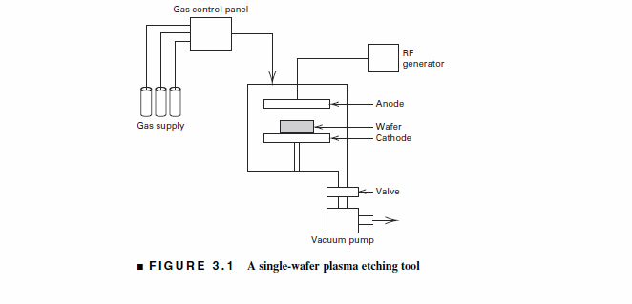
Chapter 3
Design & Analysis of Experiments 8E 2012 Montgomery

Slide 5
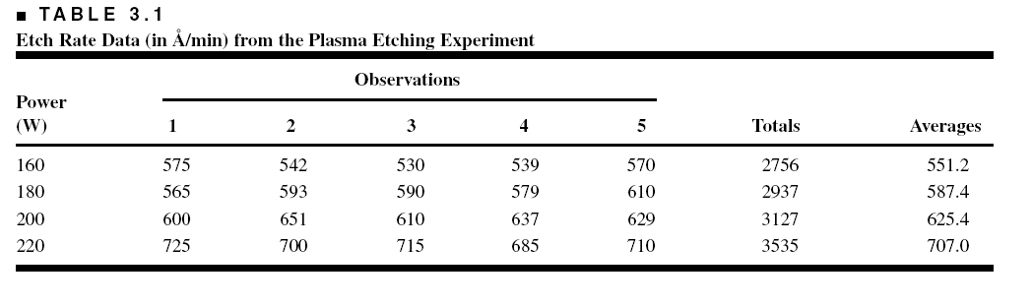
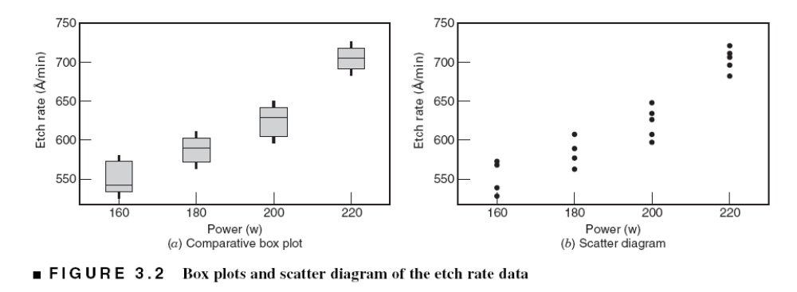
An Example (See pg. 66)
Chapter 3
Design & Analysis of Experiments 8E 2012 Montgomery

Slide 6
Does changing the power change the mean etch rate?
Is there an optimum level for power?
We would like to have an objective way to answer these questions
The t-test really doesn’t apply here – more than two factor levels
Chapter 3
Design & Analysis of Experiments 8E 2012 Montgomery

Slide 7
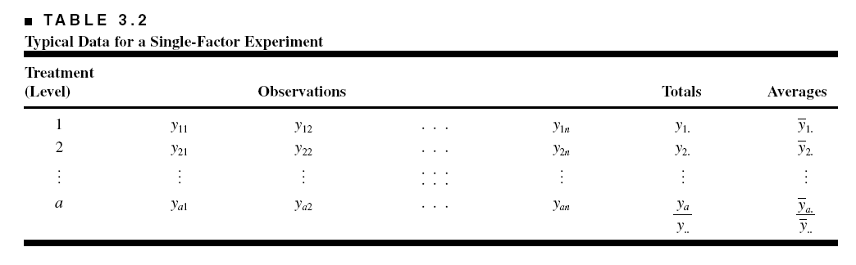
The Analysis of Variance (Sec. 3.2, pg. 68)
In general, there will be a levels of the factor, or a treatments, and n replicates of the experiment, run in random order…a completely randomized design (CRD)
N = an total runs
We consider the fixed effects case…the random effects case will be discussed later
Objective is to test hypotheses about the equality of the a treatment means
Chapter 3
Design & Analysis of Experiments 8E 2012 Montgomery

Slide 8
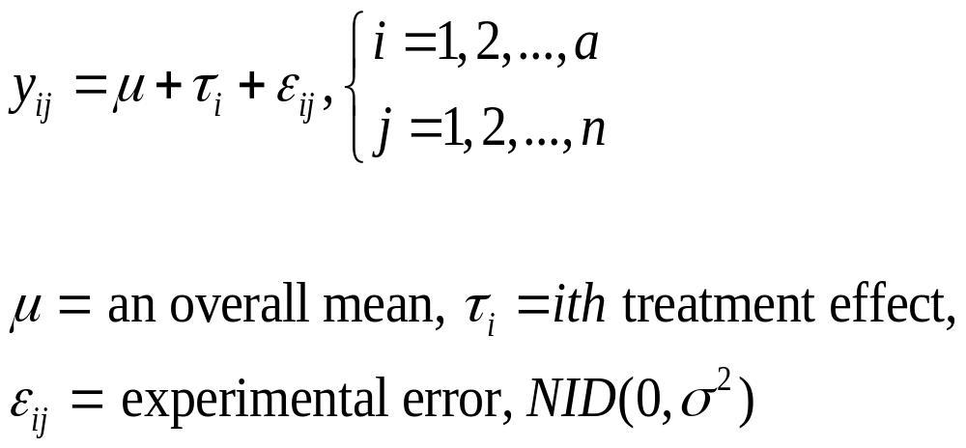
The Analysis of Variance
The name “analysis of variance” stems from a partitioning of the total variability in the response variable into components that are consistent with a model for the experiment
The basic single-factor ANOVA model is
Chapter 3
Design & Analysis of Experiments 8E 2012 Montgomery

Slide 9
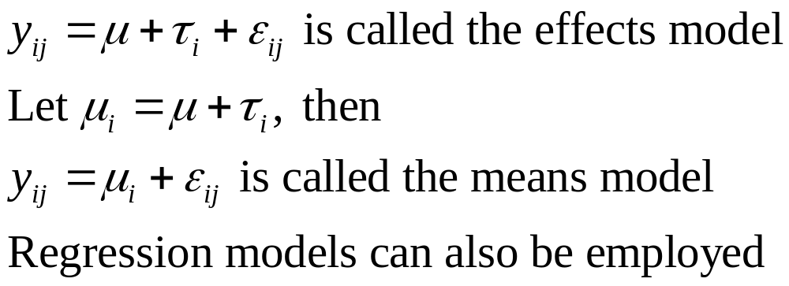
Models for the Data
There are several ways to write a model for the data:
Chapter 3
Design & Analysis of Experiments 8E 2012 Montgomery

Slide 10
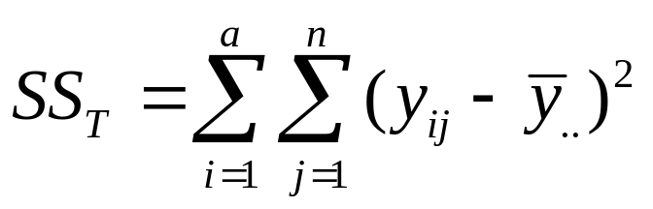
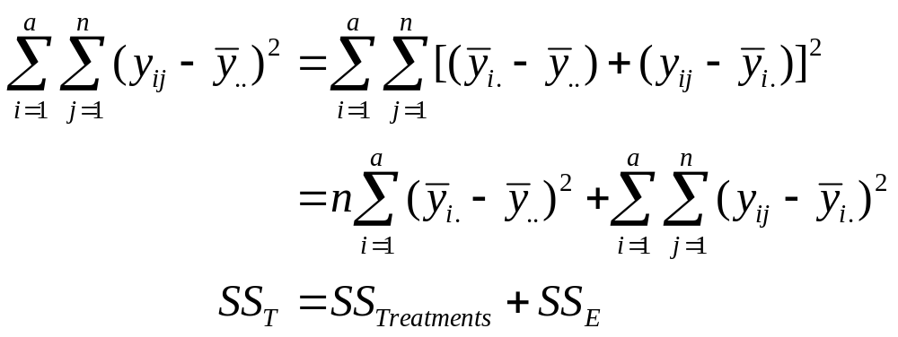
The Analysis of Variance
Total variability is measured by the total sum of squares:
The basic ANOVA partitioning is:
Chapter 3
Design & Analysis of Experiments 8E 2012 Montgomery

Slide 11
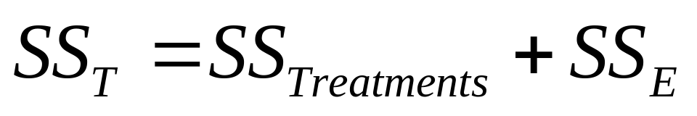
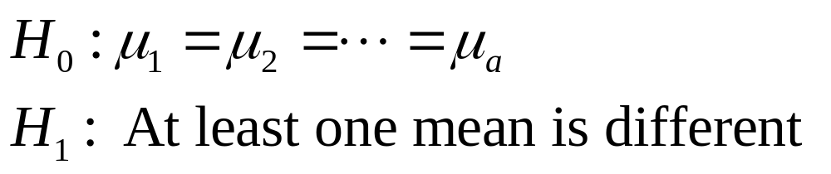
The Analysis of Variance
A large value of SS_{Treatments} reflects large differences in treatment means
A small value of SS_{Treatments} likely indicates no differences in treatment means
Formal statistical hypotheses are:
Chapter 3
Design & Analysis of Experiments 8E 2012 Montgomery

Slide 12
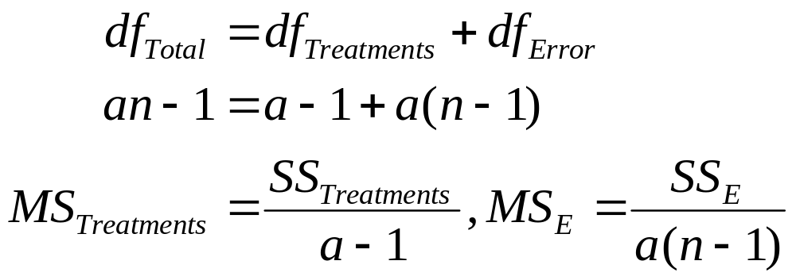
The Analysis of Variance
While sums of squares cannot be directly compared to test the hypothesis of equal means, mean squares can be compared.
A mean square is a sum of squares divided by its degrees of freedom:
If the treatment means are equal, the treatment and error mean squares will be (theoretically) equal.
If treatment means differ, the treatment mean square will be larger than the error mean square.
Chapter 3
Design & Analysis of Experiments 8E 2012 Montgomery

Slide 13
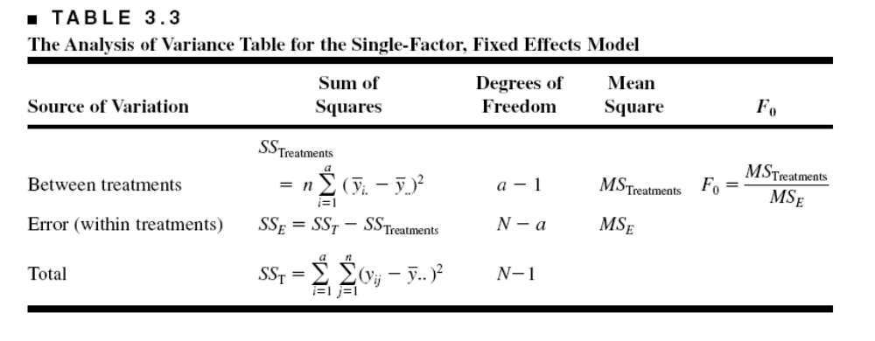

The Analysis of Variance is Summarized in a Table
Computing…see text, pp 69
The reference distribution for F₀ is the F_{a-1, a(n-1)} distribution
Reject the null hypothesis (equal treatment means) if
Chapter 3
Design & Analysis of Experiments 8E 2012 Montgomery

Slide 14
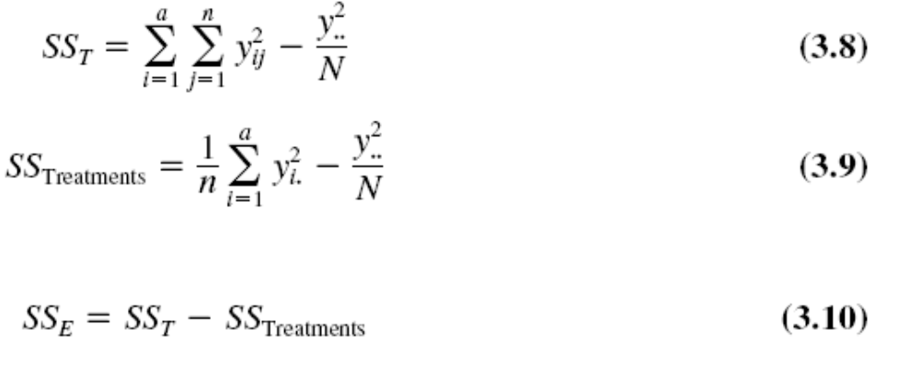
Chapter 3
Design & Analysis of Experiments 8E 2012 Montgomery

Slide 15
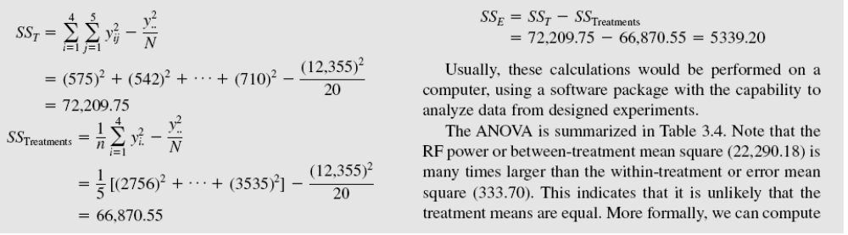
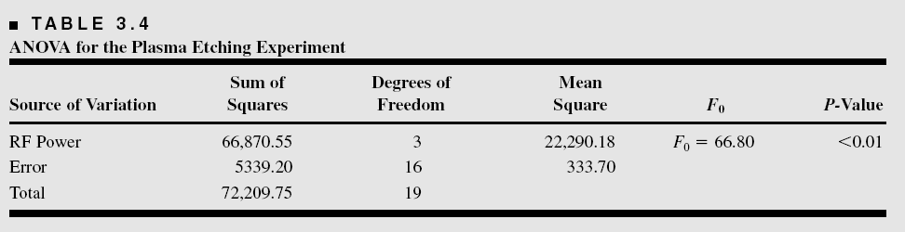
ANOVA Table
Example 3-1
Chapter 3
Design & Analysis of Experiments 8E 2012 Montgomery

Slide 16
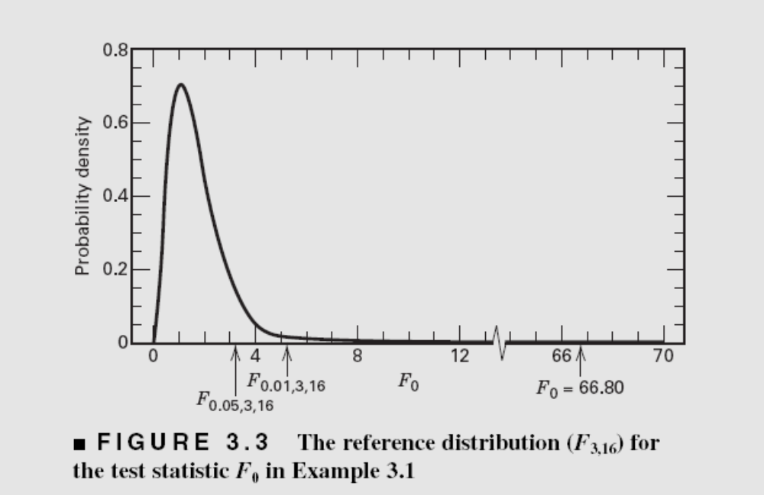
The Reference Distribution:
P-value
Chapter 3
Design & Analysis of Experiments 8E 2012 Montgomery

Slide 17
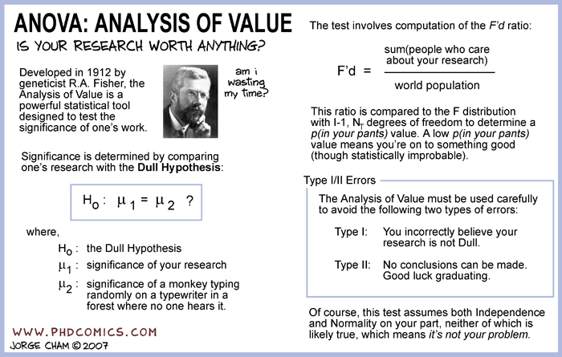
A little (very little) humor…
Chapter 3
Design & Analysis of Experiments 8E 2012 Montgomery

Slide 18
ANOVA calculations are usually done via computer
Text exhibits sample calculations from three very popular software packages, Design-Expert, JMP and Minitab
See pages 102-105
Text discusses some of the summary statistics provided by these packages
Chapter 3
Design & Analysis of Experiments 8E 2012 Montgomery

Slide 19
Model Adequacy Checking in the ANOVA
Text reference, Section 3.4, pg. 80
Checking assumptions is important
Normality
Constant variance
Independence
Have we fit the right model?
Later we will talk about what to do if some of these assumptions are violated
Chapter 3
Design & Analysis of Experiments 8E 2012 Montgomery

Slide 20
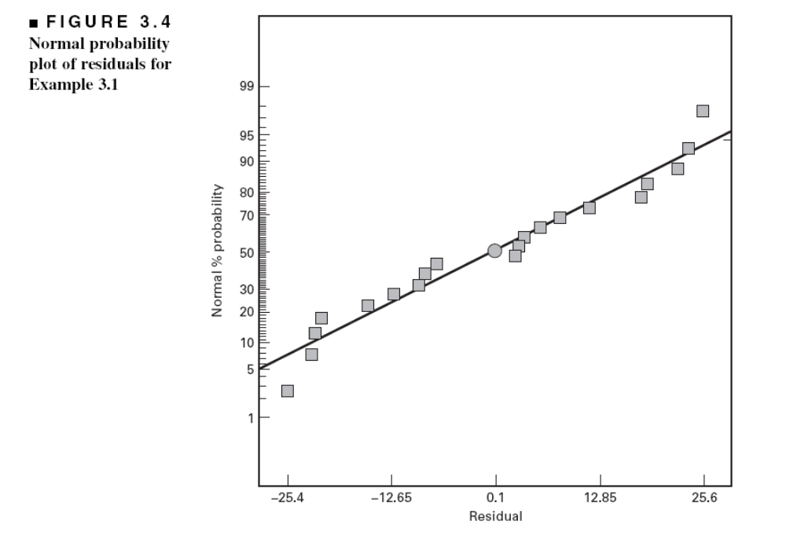
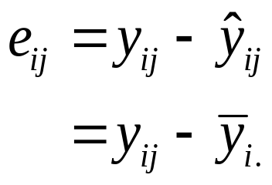
Model Adequacy Checking in the ANOVA
Examination of residuals (see text, Sec. 3-4, pg. 80)
Computer software generates the residuals
Residual plots are very useful
Normal probability plot of residuals
Chapter 3
Design & Analysis of Experiments 8E 2012 Montgomery

Slide 21
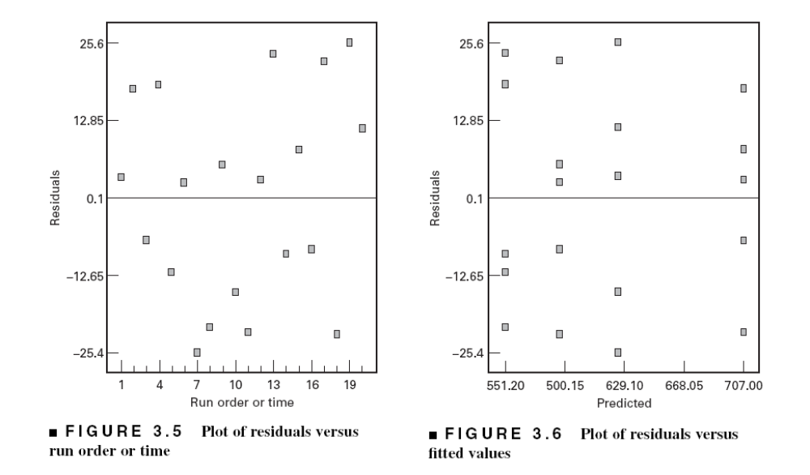
Other Important Residual Plots
Chapter 3
Design & Analysis of Experiments 8E 2012 Montgomery

Slide 22
Post-ANOVA Comparison of Means
The analysis of variance tests the hypothesis of equal treatment means
Assume that residual analysis is satisfactory
If that hypothesis is rejected, we don’t know which specific means are different
Determining which specific means differ following an ANOVA is called the multiple comparisons problem
There are lots of ways to do this…see text, Section 3.5, pg. 89
We will use pairwise t-tests on means…sometimes called Fisher’s Least Significant Difference (or Fisher’s LSD) Method
Chapter 3
Design & Analysis of Experiments 8E 2012 Montgomery

Slide 23
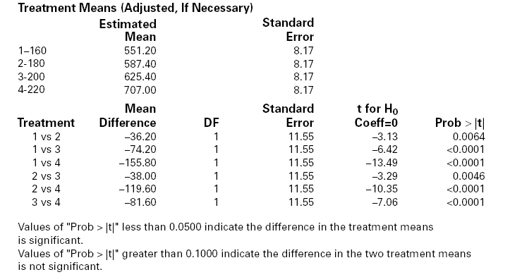
Design-Expert Output
Chapter 3
Design & Analysis of Experiments 8E 2012 Montgomery

Slide 24
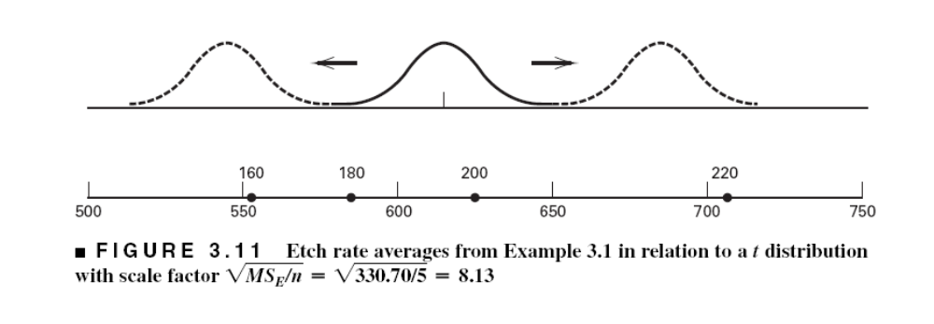
Graphical Comparison of Means
Text, pg. 91
Chapter 3
Design & Analysis of Experiments 8E 2012 Montgomery

Slide 25

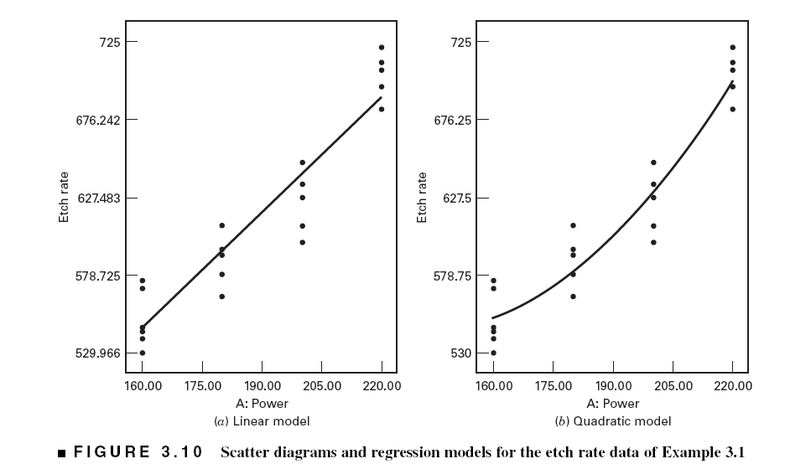
The Regression Model
Chapter 3
Design & Analysis of Experiments 8E 2012 Montgomery

Slide 26
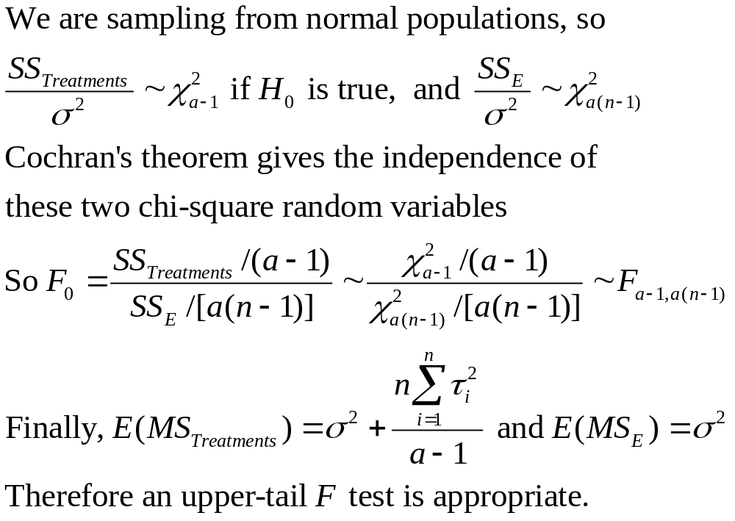
Why Does the ANOVA Work?
Chapter 3
Design & Analysis of Experiments 8E 2012 Montgomery

Slide 27
Sample Size Determination
Text, Section 3.7, pg. 105
FAQ in designed experiments
Answer depends on lots of things; including what type of experiment is being contemplated, how it will be conducted, resources, and desired sensitivity
Sensitivity refers to the difference in means that the experimenter wishes to detect
Generally, increasing the number of replications increases the sensitivity or it makes it easier to detect small differences in means
Chapter 3
Design & Analysis of Experiments 8E 2012 Montgomery

Slide 28



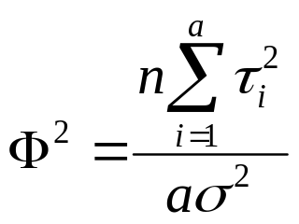
Sample Size Determination
Fixed Effects Case
Can choose the sample size to detect a specific difference in means and achieve desired values of type I and type II errors
Type I error – reject H₀ when it is true ( )
Type II error – fail to reject H₀ when it is false ( )
Power = 1 -
Operating characteristic curves plot against a parameter where
Chapter 3
Design & Analysis of Experiments 8E 2012 Montgomery

Slide 29

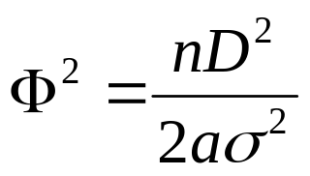

Sample Size Determination
Fixed Effects Case---use of OC Curves
The OC curves for the fixed effects model are in the Appendix, Table V
A very common way to use these charts is to define a difference in two means D of interest, then the minimum value of is
Typically work in term of the ratio of and try values of n until the desired power is achieved
Most statistics software packages will perform power and sample size calculations – see page 108
There are some other methods discussed in the text
Chapter 3
Design & Analysis of Experiments 8E 2012 Montgomery

Slide 30
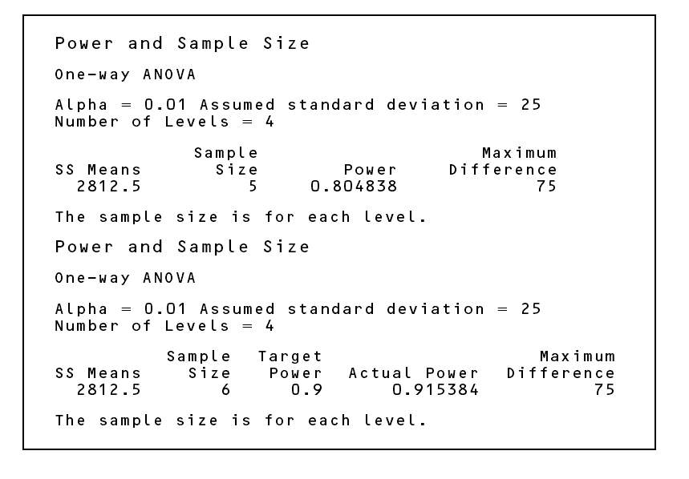
Power and sample size calculations from Minitab (Page 108)
Chapter 3
Design & Analysis of Experiments 8E 2012 Montgomery

Slide 31
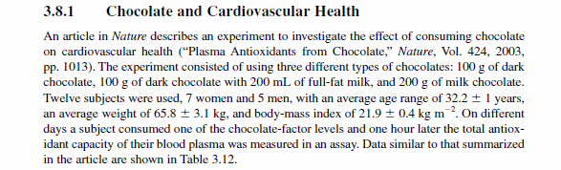
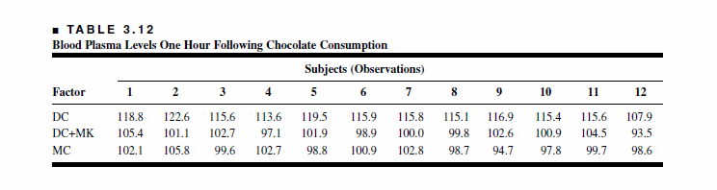
3.8 Other Examples of Single-Factor Experiments
Chapter 3
Design & Analysis of Experiments 8E 2012 Montgomery

Slide 32
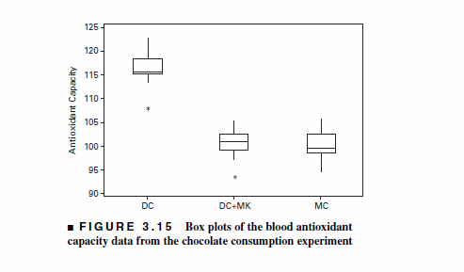
Chapter 3
Design & Analysis of Experiments 8E 2012 Montgomery

Slide 33
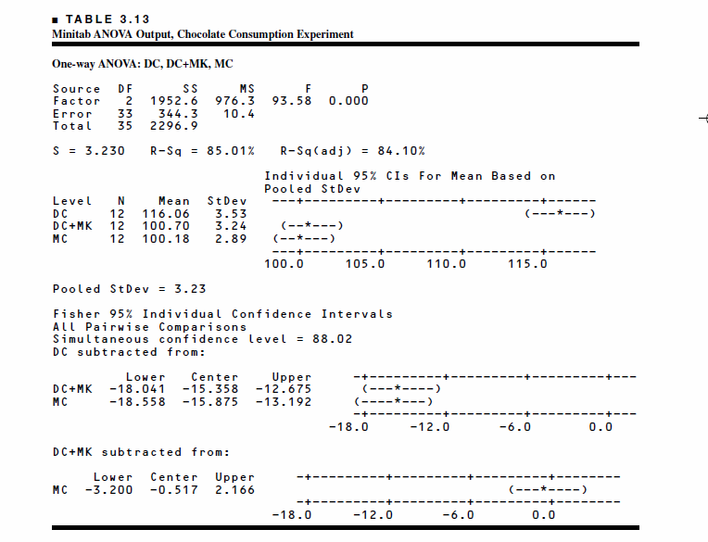
Conclusions?
Chapter 3
Design & Analysis of Experiments 8E 2012 Montgomery

Slide 34
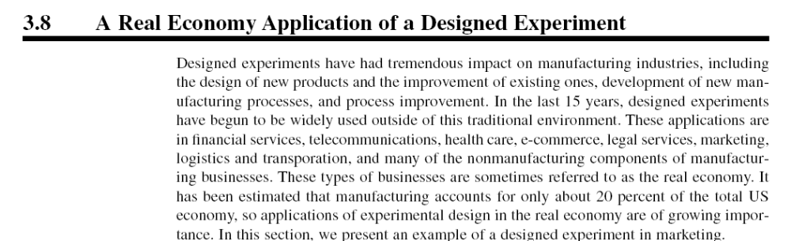
Chapter 3
Design & Analysis of Experiments 8E 2012 Montgomery

Slide 35
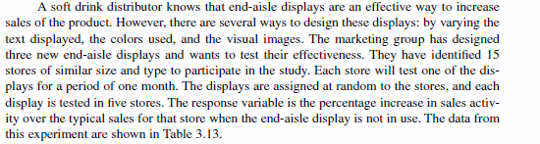
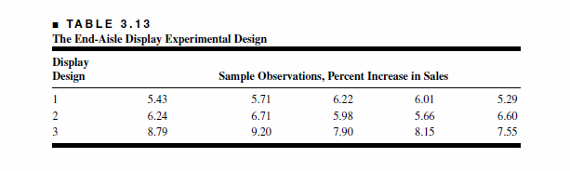
Chapter 3
Design & Analysis of Experiments 8E 2012 Montgomery

Slide 36
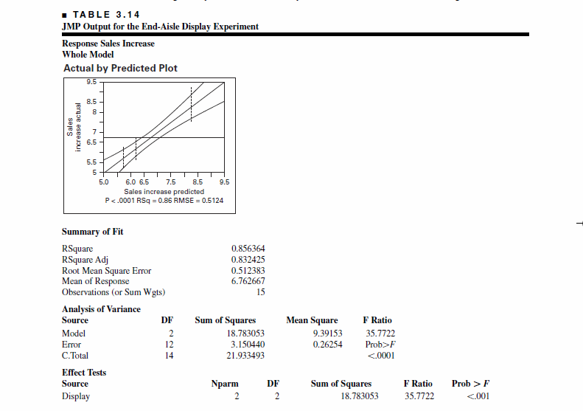
Chapter 3
Design & Analysis of Experiments 8E 2012 Montgomery

Slide 37
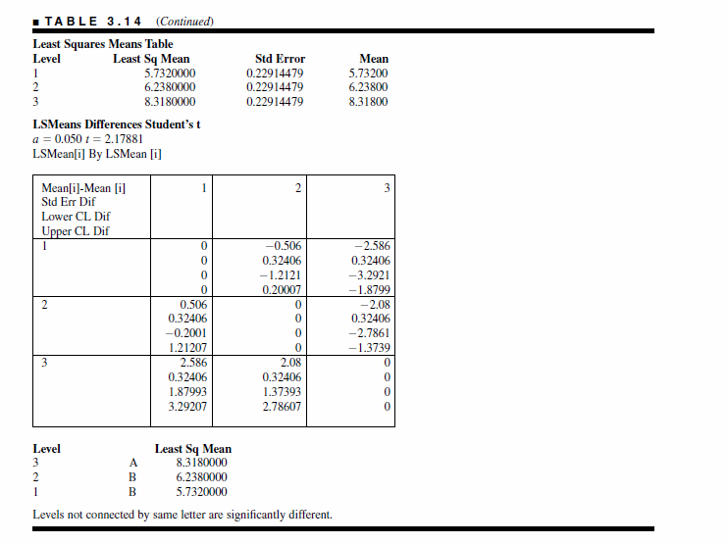
Chapter 3
Design & Analysis of Experiments 8E 2012 Montgomery

Slide 38
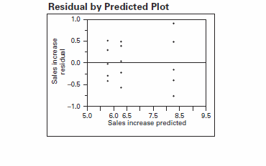
Chapter 3
Design & Analysis of Experiments 8E 2012 Montgomery

Slide 39
3.9 The Random Effects Model
Text reference, page 118
There are a large number of possible levels for the factor (theoretically an infinite number)
The experimenter chooses a of these levels at random
Inference will be to the entire population of levels
Chapter 3
Design & Analysis of Experiments 8E 2012 Montgomery

Slide 40
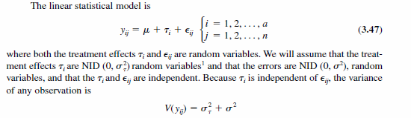
Variance components
Chapter 3
Design & Analysis of Experiments 8E 2012 Montgomery

Slide 41
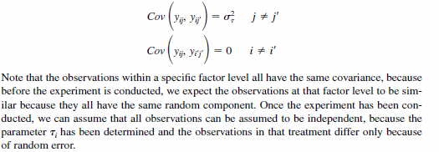
Covariance structure:
Chapter 3
Design & Analysis of Experiments 8E 2012 Montgomery

Slide 42
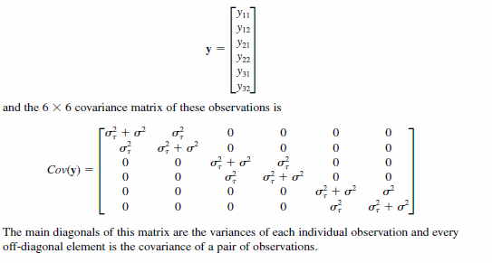
Observations (a = 3 and n = 2):
Chapter 3
Design & Analysis of Experiments 8E 2012 Montgomery

Slide 43
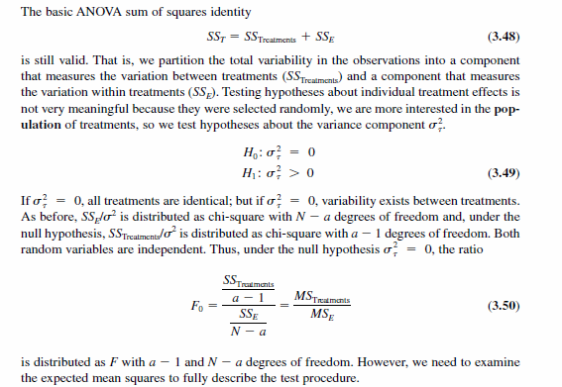
Chapter 3
Design & Analysis of Experiments 8E 2012 Montgomery

Slide 44
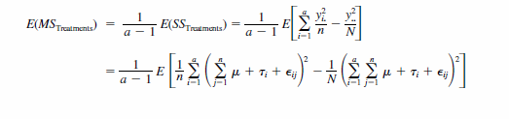
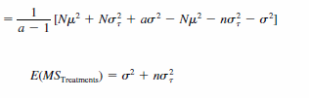

ANOVA F-test is identical to the fixed-effects case
Chapter 3
Design & Analysis of Experiments 8E 2012 Montgomery

Slide 45


Estimating the variance components using the ANOVA method:
Chapter 3
Design & Analysis of Experiments 8E 2012 Montgomery

Slide 46
The ANOVA variance component estimators are moment estimators
Normality not required
They are unbiased estimators
Finding confidence intervals on the variance components is “clumsy”
Negative estimates can occur – this is “embarrassing”, as variances are always non-negative
Chapter 3
Design & Analysis of Experiments 8E 2012 Montgomery

Slide 47
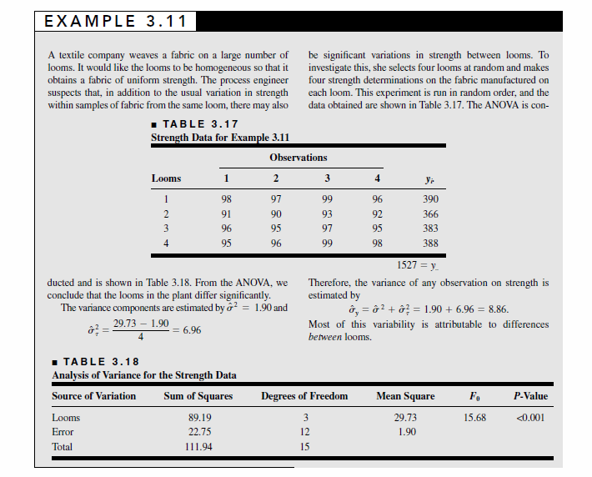
Chapter 3
Design & Analysis of Experiments 8E 2012 Montgomery

Slide 48


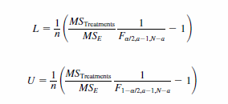
Confidence interval for the error variance:
Confidence interval for the interclass correlation:
Chapter 3
Design & Analysis of Experiments 8E 2012 Montgomery

Slide 49
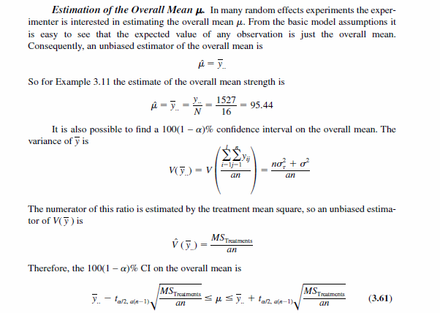
Chapter 3
Design & Analysis of Experiments 8E 2012 Montgomery

Slide 50
Maximum Likelihood Estimation of the Variance Components
The likelihood function is just the joint pdf of the sample observations with the observations fixed and the parameters unknown:
Choose the parameters to maximize the likelihood function
Chapter 3
Design & Analysis of Experiments 8E 2012 Montgomery

Slide 51
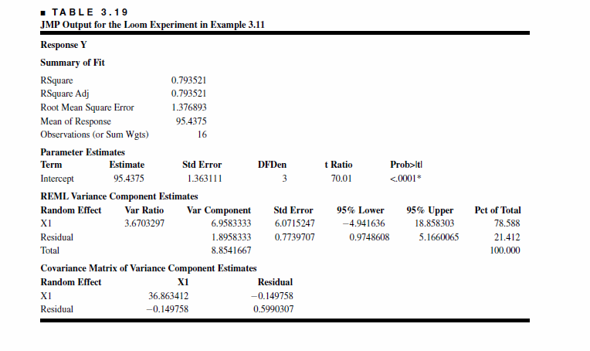
Residual Maximum Likelihood (REML) is used to estimate variance components
Point estimates from REML agree with the moment estimates for balanced data
Confidence intervals
Chapter 3
Design & Analysis of Experiments 8E 2012 Montgomery

